Slide 1
Surviving the Titanic
Mike Dean

Slide 2
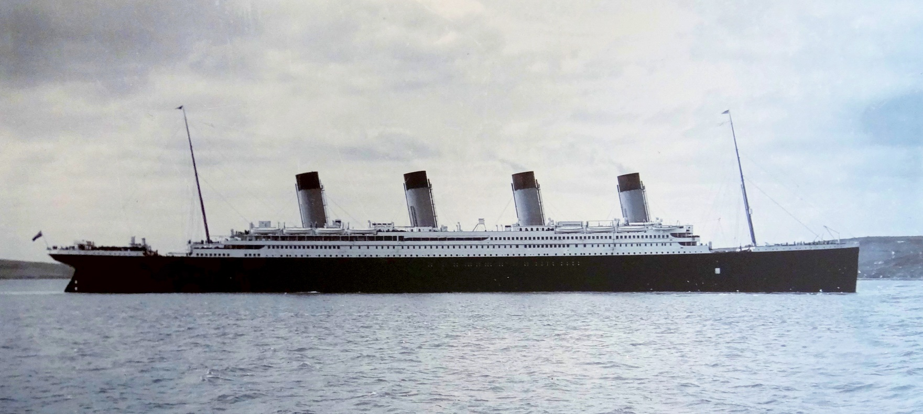
Overview
Background
Data
Methods
Results

Slide 3
Background
Maiden Voyage from Southampton, UK to New York, NY.
(Number) passengers onboard.
Manned by a crew of (Number).
Sent off course by (Why?) and struck an iceberg.
(Number) of lifeboats onboard which could hold (number) of passengers/crew each.
(Number) of people died with a survival rate of (percent)

Slide 4
Evacuation
As was (and still is) common, the evacuation took a “Women and Children first” policy.
The ship took (number) hours to sink.

Slide 5
Data

Slide 6
Survival Rates by Age, Sex, and Class

Slide 7
Methods
Excel – Pivot Tables
Python – Random Forest
R – Decision Tree & Random Forest

Slide 8
Results

Slide 9
Two Content Layout with Table
First bullet point here
Second bullet point here
Third bullet point here
 | Group 1 | Group 2
Class 1 | 82 | 95
Class 2 | 76 | 88
Class 3 | 84 | 90

Slide 10
Two Content Layout with SmartArt
First bullet point here
Second bullet point here
Third bullet point here
Group A
Group B
Group C

